Slide 1
Git hub

Slide 2
What is version control system?
A way to manage files and directories
Track changes over time
Recall previous versions
‘Source control’ is a subset of version control system.
It was originally designed for coordinating work among programmers who were operating source codes during software development.

Slide 3
What is Git?
Created by linus Torvalds, April 2005.
It is a command line version control system
It is Distributed version control system
It is cross-platform(including Windows).
It is open source, free.
How you get Git?
http://git-scm.com

Slide 4
Benefits of Git
It’s free (and open-source): You can freely contribute to the code any time and, of course, you don’t need to purchase it, since it is open-source.
Performance: It is faster and more reliable than any other version control software as it focuses only on file content rather than on file names.
Security: Git protects the code and the change history through a cryptographically secure hashing algorithm, called SHA1.
Widely-used: Git has become the preferred VCS tool in many great organizations.

Slide 5
Introduction to Git Hub
GitHub is a collaboration platform that uses Git for versioning. GitHub is a popular place to share and contribute to open source software.
In github every one has the copy of the project.
Github is the largest community of the developers in the world with millions of peoples sharing their projects and data.

Slide 6
Repository
A Repository is a project containing files and folders. A repository tracks versions of filed and folders.
Its a container that holds everything related with the project, it contains project code, documents and other important files.

Slide 7
Branch
branch is a parallel version of your repository. By default, your repository has one branch named main and it is considered to be the definitive branch.
You can create additional branches off of main in your repository.
On additional branches, you can make edits without impacting the main version.
Branches allow you to separate your work from the main branch. In other words, everyone's work is safe while you contribute.

Slide 8
Pull Request
Collaboration happens on a pull request. The pull request shows the changes in your branch to other people.
This pull request is going to keep the changes you just made on your branch and propose applying them to the main branch.
It represents a change which let issue others the changes so they can discuss and review changes which you have made.

Slide 9
Issues
Issues are discussion threads where people can report bugs,request features or ask question.
What is a merge:
A merge adds the changes in your pull request and branch into the main branch.
What is a merge conflict?:
A merge conflict occurs when changes are made to the same part of the same file on two different branches. You usually find out about conflicts in a pull request.

Slide 10
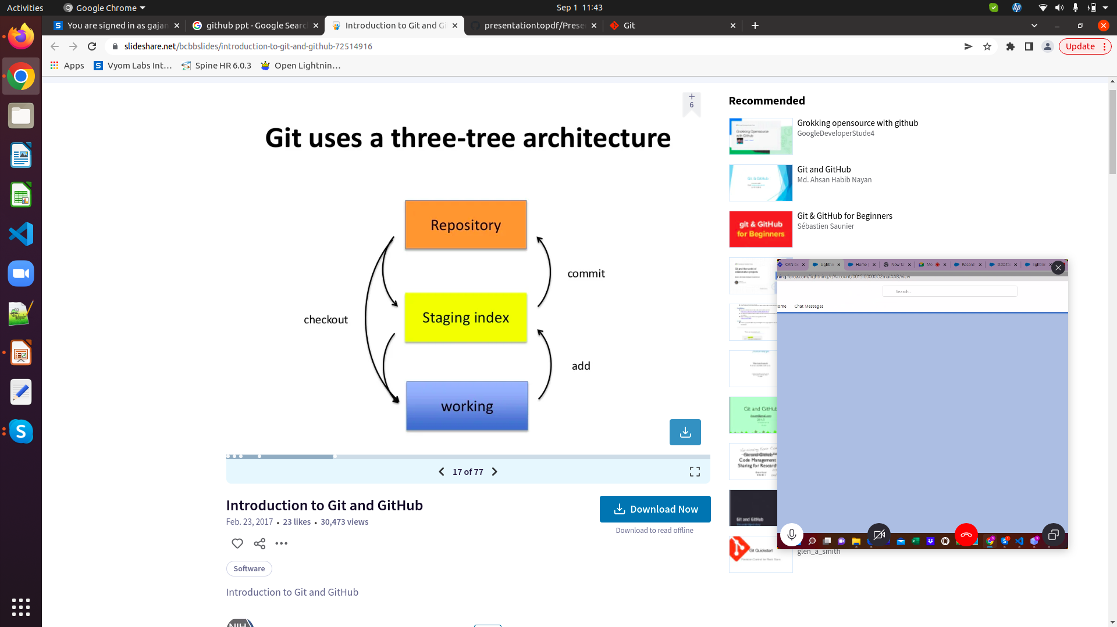
Git uses a Three-tier Architecture

Slide 11
Git Commands
git config
The git config command is used initially to configure the user.name and user.email. This specifies what email id and username will be used from a local repository.
When git config is used with --global flag, it writes the settings to all repositories on the computer.
git config –global user.name “Gajanan Deshmukh”
git config –global user.email “Gajanana.deshmukh@infosys.com”

Slide 12
Git Commands
git init: This is the command you need to use if you want to start a new empty repository or to reinitialize an existing one in the project root. It will create a .git directory with its subdirectories. It should look like this:
git init <repository name>
git add:
This is the command you need to use the stage changed files. You can stage individual files.
git add <file path>
Or all files
Or Git add .

Slide 13
git commit: This one is probably the most used Git command. After changes are done locally, you can save them by “committing” them.
A commit is like local a snapshot of the current state of the branch, to which you can always come back.
To create a new commit, type this command in Git Bash:
git commit -m<message>

Slide 14
git status – it allows one to see where files are in the three tree structure.
git Status
Git Branch:
It is used to create a new branch in your repo.
Git branch <name of branch>
git pull
Using git pull will fetch all the changes from the remote repository and merge any remote changes in the current local branch.
git pull

Slide 15
git push : Git push will push the locally committed changes to the remote branch. If the branch is already remotely tracked, simply use it like this (with no parameters):
Syntax: git push
git push origin master – it will make changes to the master branch.

Slide 16
git checkout: You can use the checkout command to switch the branch that you are currently working on.
git checkout <branch name>
git Clone: This command is used for downloading the latest version of a remote project and copying it to the selected location on the local machine. It looks like this:
git clone <repository url>

Slide 17
git merge
The git merge command is used to integrate the branches together. The command combines the changes from one branch to another branch.
It is used to merge the changes in the staging branch to the stable branch.
git merge <branch_name>

Slide 18
Deleting files from the repo:
git rm filename.txt
It will move deleted file change to staging area
It is not enough to delete the file in your working directory. You must commit the change.
Deleting the Branch
You can delete the branch with the command.
Git push origin –delete <branch name>

Slide 19
git diff-
You can use this command to see the unstaged changes on the current branch. Here’s an example of a branch with an edited feature file:
git diff –staged

Slide 20
Thank you

